Slide 1

John Doe
4th
25/05/2026

Slide 2
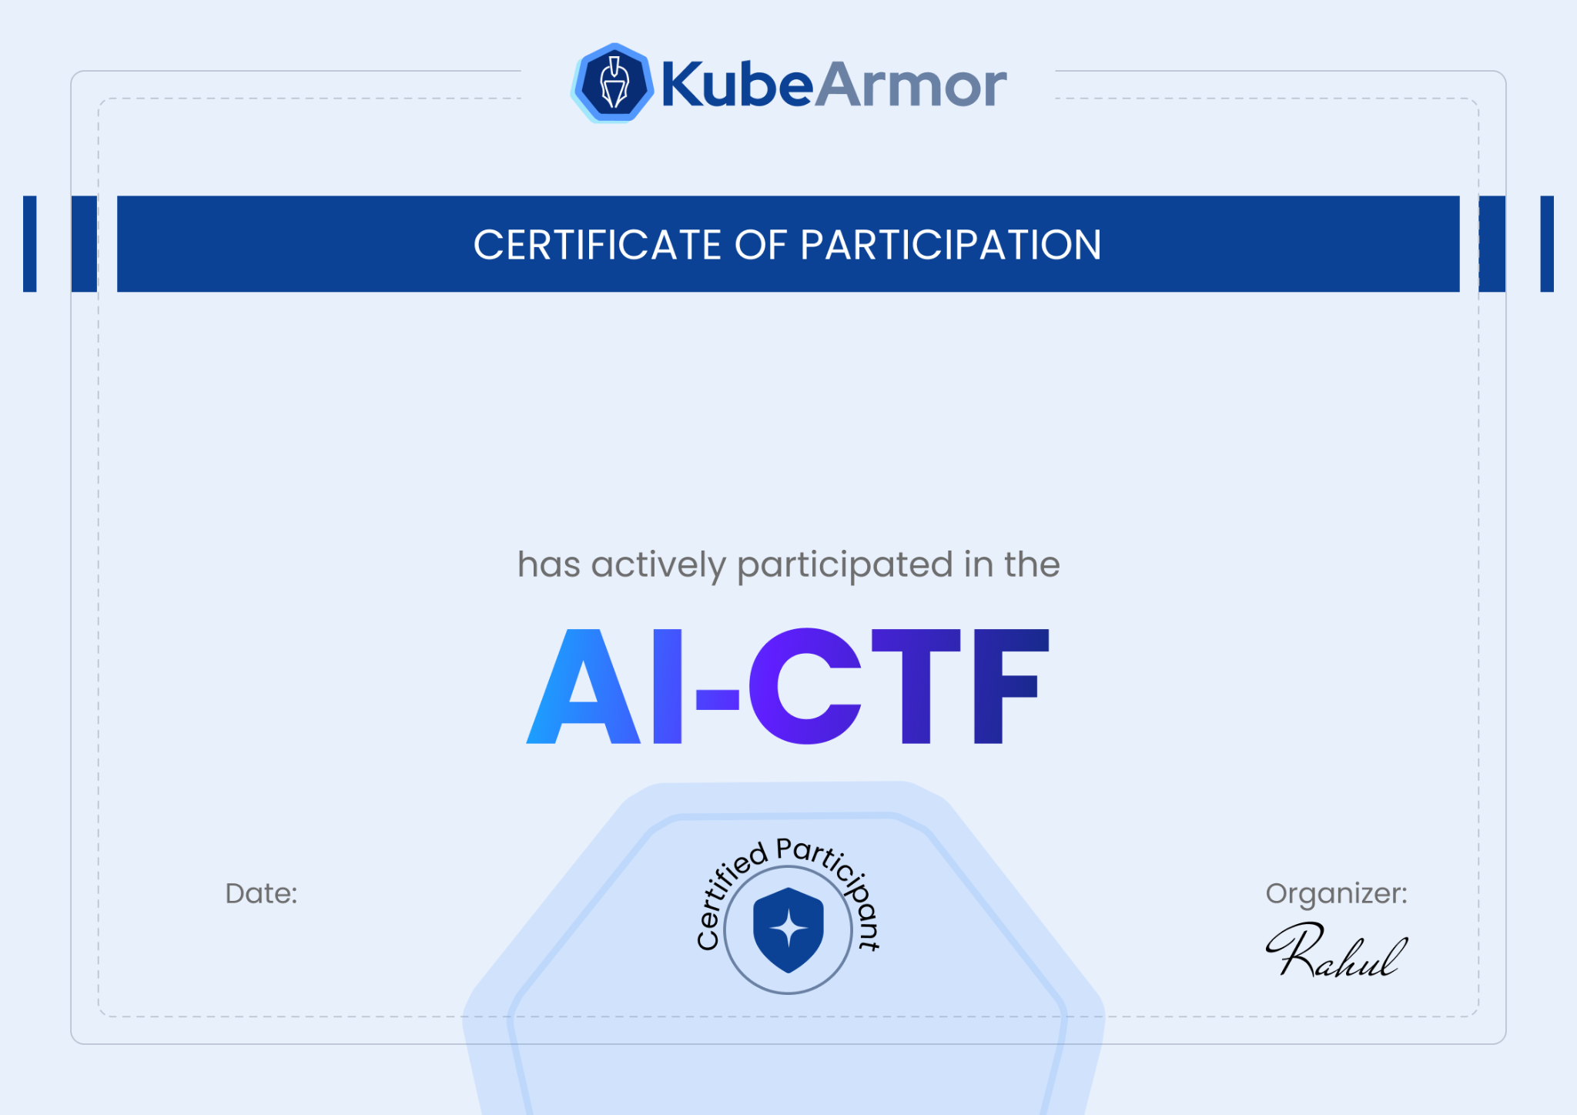
John Doe
25/05/2026

